Slide 1
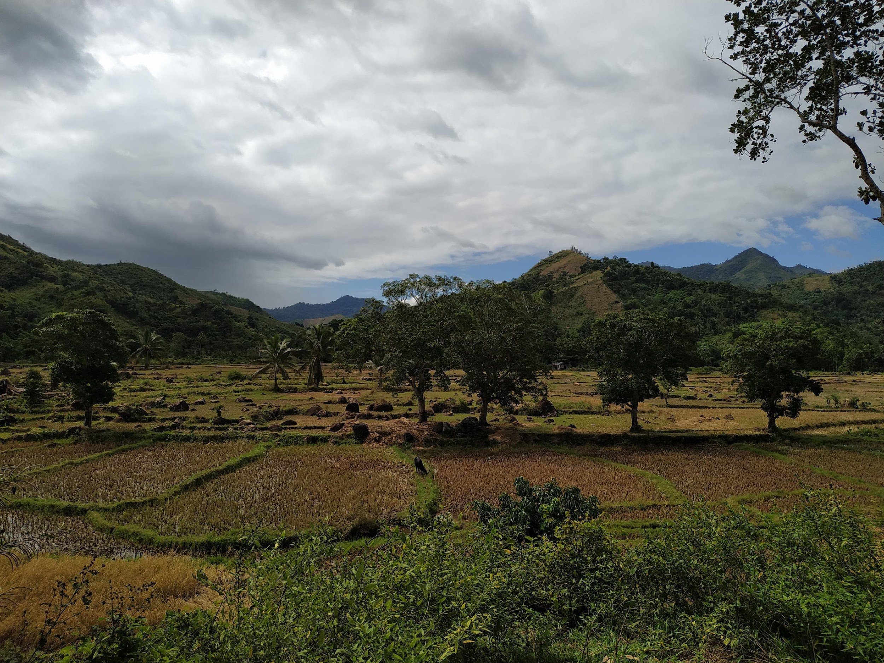


The Interplay Between Host Microbiome, Host Pathogens, And Human Land Use Management, With Association To Disease Risk
Matan Markfeld
14 March 2024

Slide 2
Land use and microbe prevalence jointly determine host-microbe network structure
Matan Markfeld, Georgia Titcomb, Charles Nunn, Shai Pilosof
March 14, 2024

Slide 3
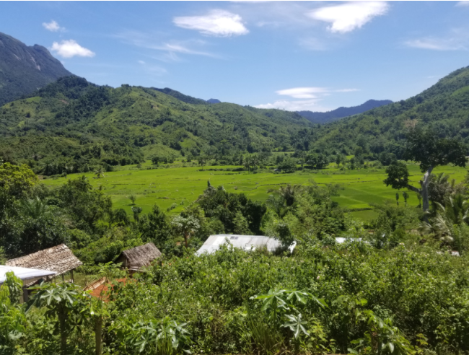
Land use change
Forest
Agriculture
Village
Host Microbiome
Newbold et. al., 2015; Bernardo-Carvo et. al., 2020; Fackelmann et. al., 2021
Notes:
This land use change negatively impact ecological communities.
One of these communities is the microbial community or the host microbiome.

Slide 4
Land use change
Host community change
Forest
Agriculture
Village
Host Microbiome
Newbold et. al., 2015; Bernardo-Carvo et. al., 2020; Fackelmann et. al., 2021
Notes:
land use change can alter the host microbiome in different ways. It changes the host community composition and abundance, which can affect the transmission of microbes between hosts.

Slide 5
Land use change
Host community change
Human-Wildlife interface
Forest
Agriculture
Diet shift
Village
Host Microbiome
Newbold et. al., 2015; Bernardo-Carvo et. al., 2020; Fackelmann et. al., 2021
Notes:
Additionally, Human-wildlife interface is changed with agricultural practices. This can lead to diet shift of the host and to changes in the gut conditions.
and of course, that also can expose animals to human microbes and pathogens.

Slide 6
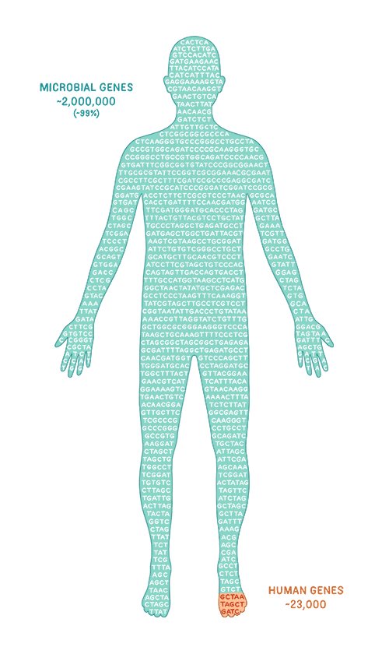


The microbiome is crucial for host health and function
Knowledge gap –
While most microbiome research focuses on humans or domestic animals, we still don’t know a lot about wild animals and how environmental factors, such as land use change, affect their microbiome
Berg et. al., 2020; Rosenberg & Zilber-Rosenberg, 2018
Notes:
All of theses microbiome changes may be important since the microbiome is crucial for the host health and function. Changes to the microbiome might change the host’s function and make it more susceptible to disease, for example.
However, while most moicrobiome research focuses on humans or domestic animals, we still don’t know a lot about wild animals and how environmental factors, such as land use change, affect their microbiome.

Slide 7
Research objective
To explore how land use change shapes the structure of host-microbe communities
Research questions
Is there a signature of land use in the structure of host-microbe network?
Do hosts from the same land use have similar interaction patterns with microbes?
Does host-microbe interaction density change in accordance with land use?
Is there a difference between the two host species?

Slide 8
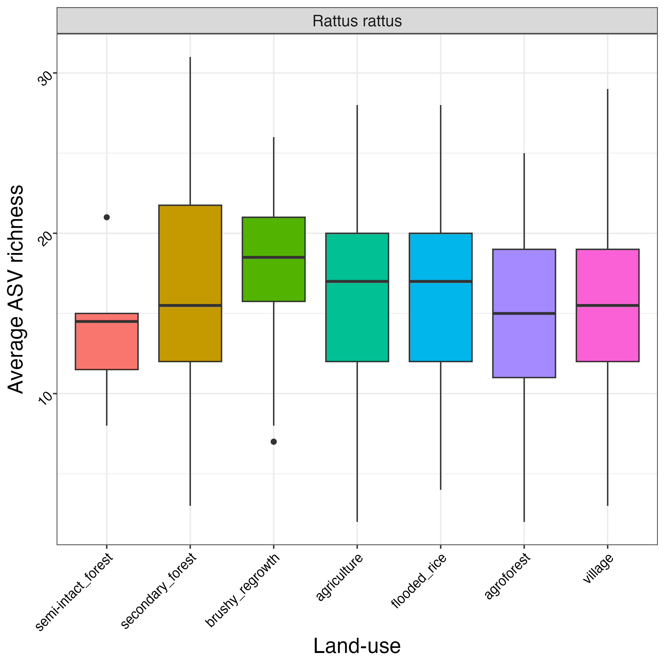
ASVs richness is not changed across land use

Slide 9
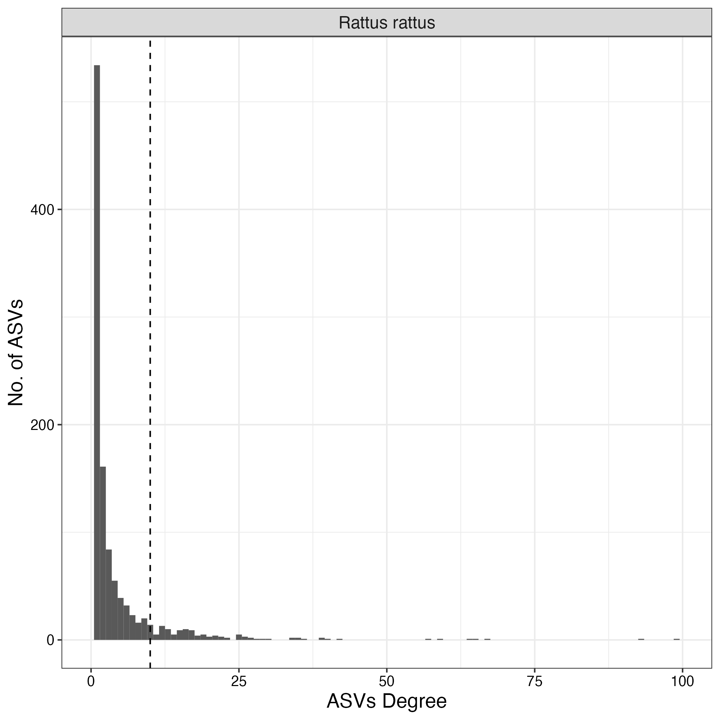
Degree distribution
Connectance:
Rattus = 1.5%
Most ASVs occur in less than 10 hosts

Slide 10
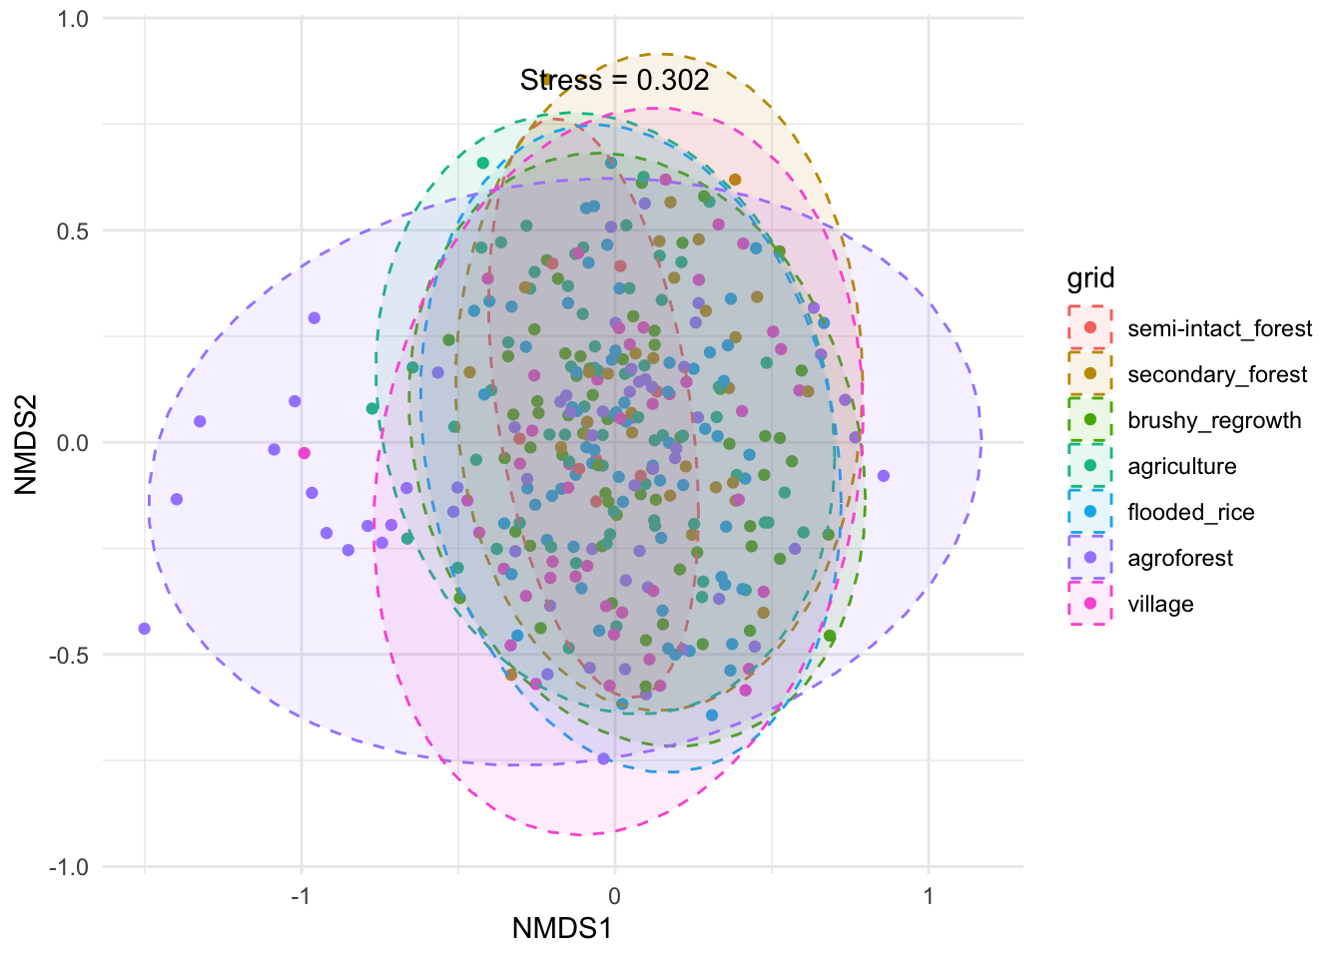
High inter-individual microbiome variation
Beta-diversity [Jaccard] = 0.05
F = 1.23, p < 0.01

Slide 11
We can explore the host-microbes network in the meso-scale We hypothesize that if land use has a strong effect on the microbiome, hosts from the same land use have a similar pattern of connections to microbes
Microbes
Hosts
Agroforest
Rice
Forest

Slide 12
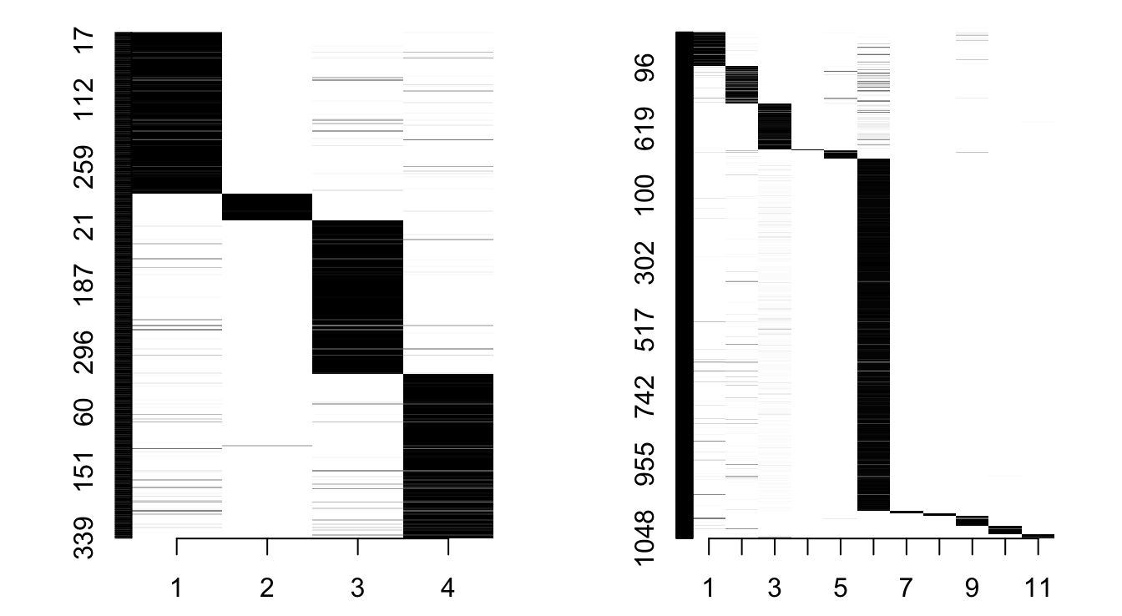
Community detection - Stochastic Block Model
4 host groups
11 ASVs groups
Leger, 2016; Allesina & Pascual, 2009

Slide 13
Does land use explain the network group structure?
Normalized Mutual Information
NMI = 0.04
p < 0.01
 | LU1 | LU2 | LU3 | LU4 | LU5
Group 1 | 10
Group 2 |  | 10
Group 3 |  |  | 10
Group 4 |  |  |  | 10
Group 5 |  |  |  |  | 10

Slide 14
ASVs association to land use
Group 1
Agroforest
Rice
Forest
8 links
80%
1 link
10%
1 link
10%

Slide 15
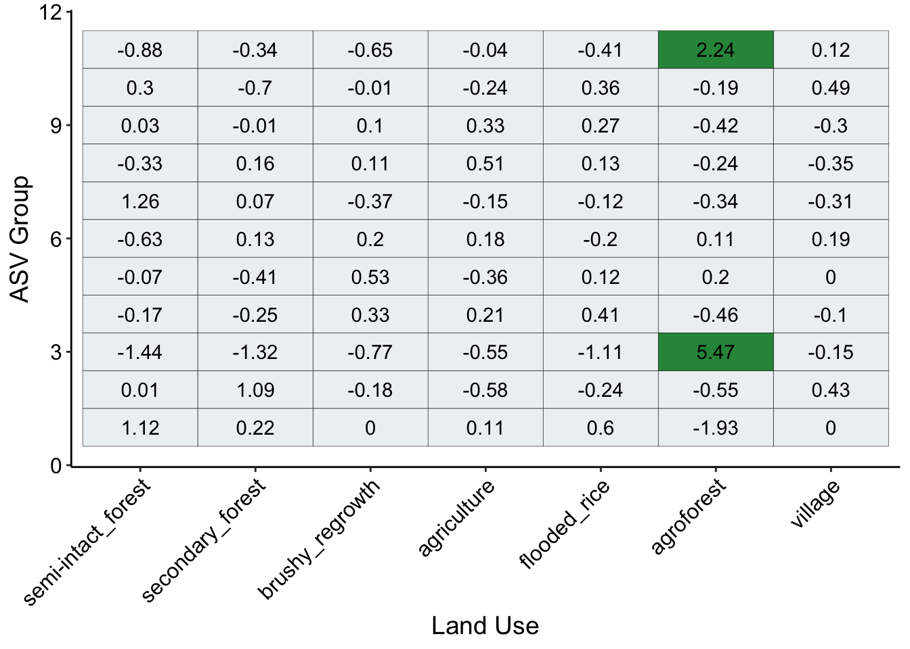
Specific ASVs groups are associated with specific land uses
Positive association
Negative association

Slide 16
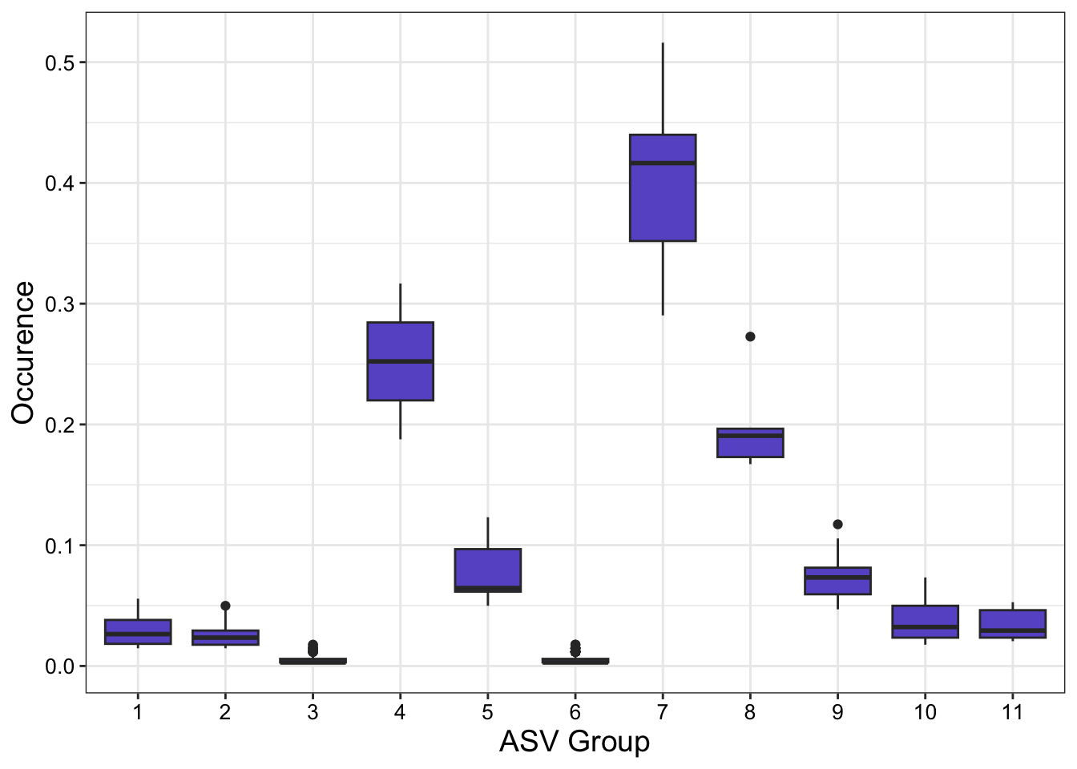
ASVs occurrence

Slide 17
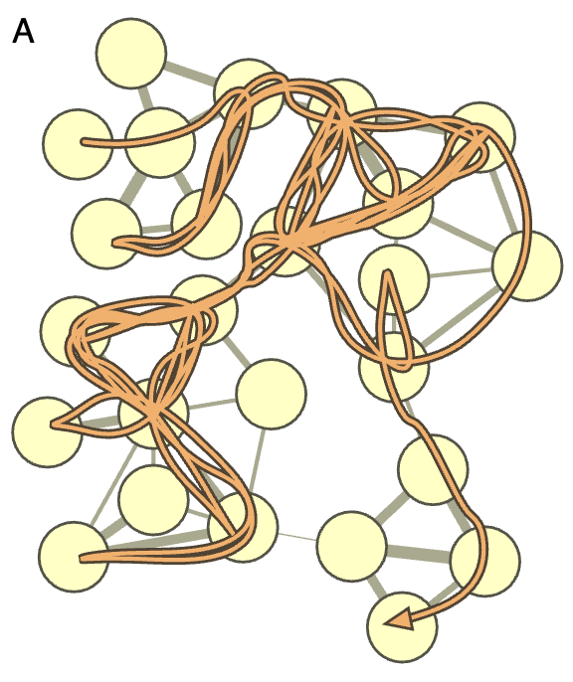
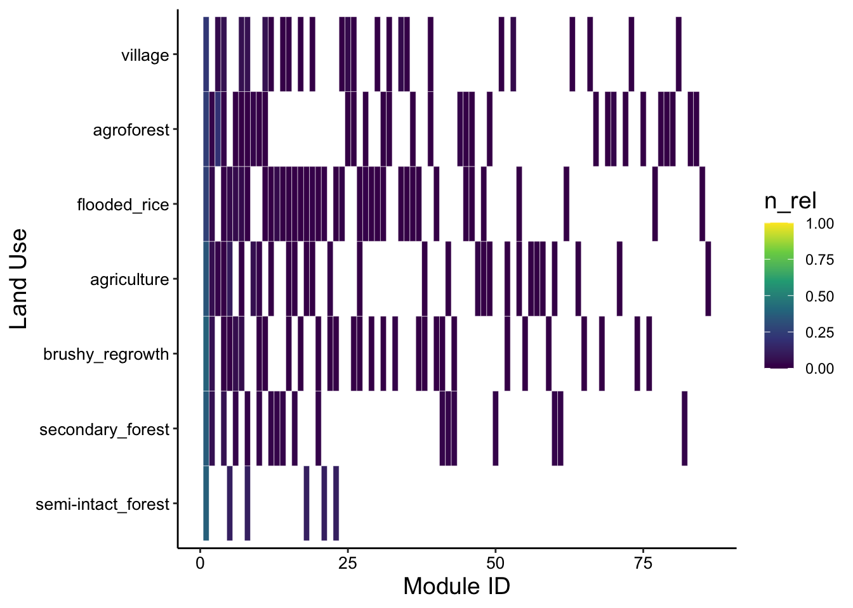
86 modules
Community detection - Infomap

Slide 18
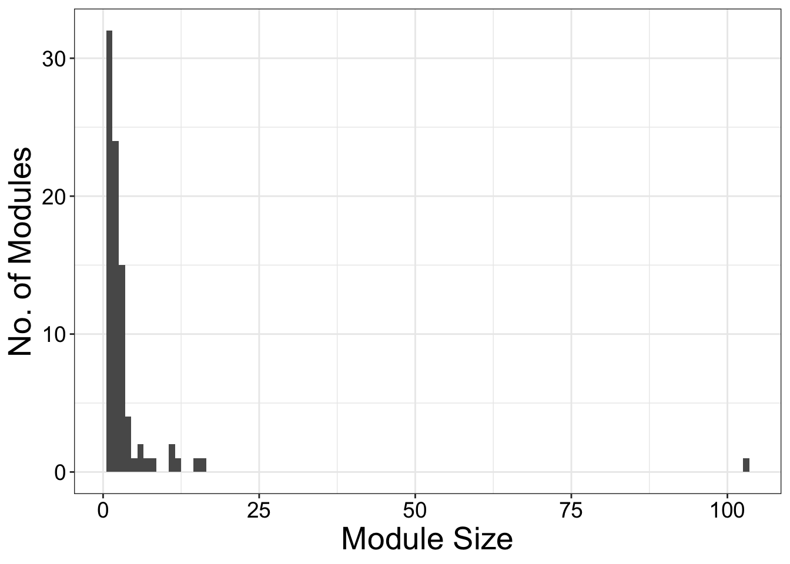
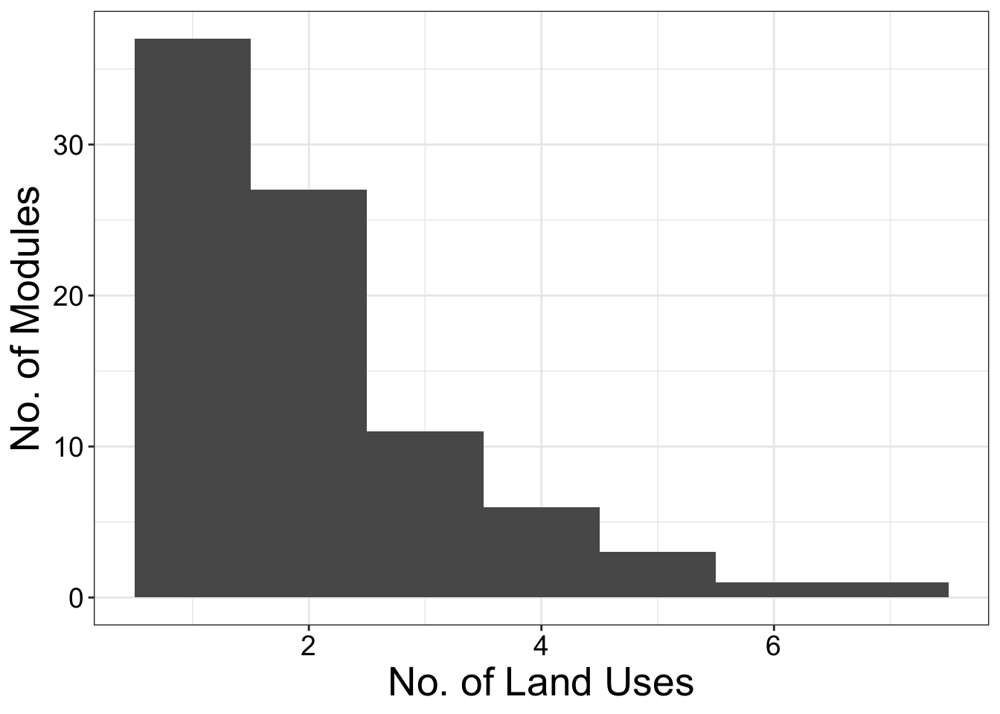
Community detection - Infomap
86 groups
Rosvall et. al., 2010; Farage et. al., 2021

Slide 19
Community detection - Infomap
Rosvall et. al., 2010; Farage et. al., 2021

Slide 20
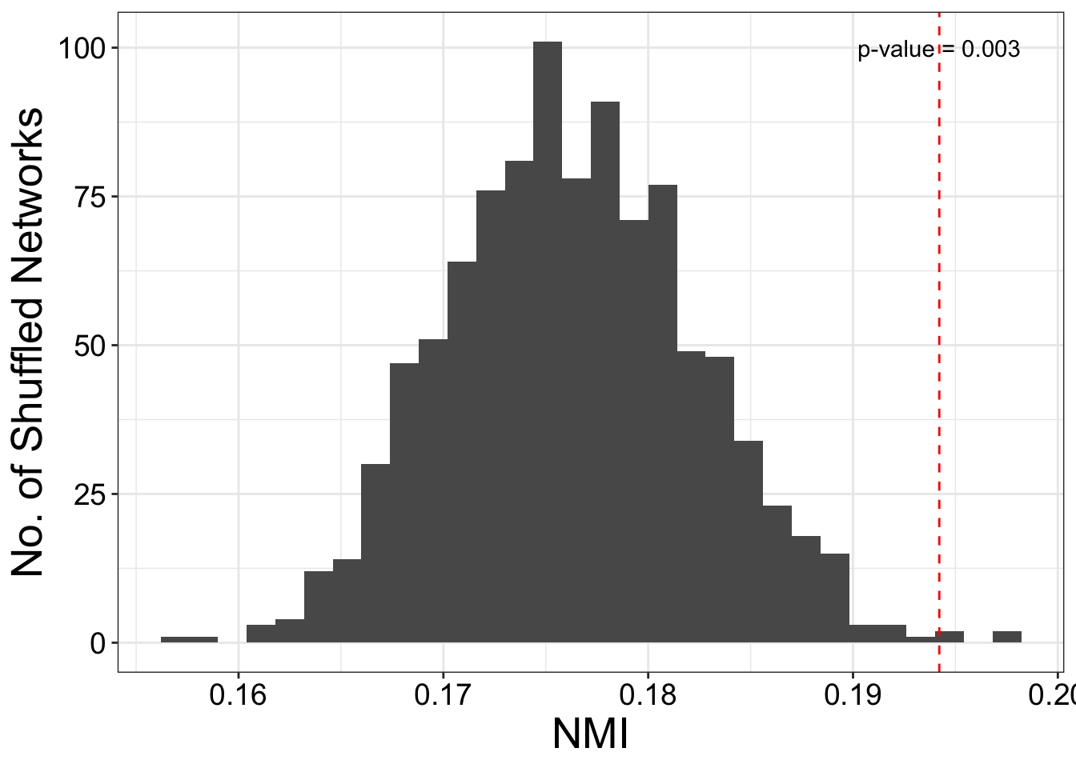
Does land use explain the network group structure?
Normalized Mutual Information
NMI = 0.19
p < 0.01
 | LU1 | LU2 | LU3 | LU4 | LU5
Group 1 | 10
Group 2 |  | 10
Group 3 |  |  | 10
Group 4 |  |  |  | 10
Group 5 |  |  |  |  | 10
Taya et. al., 2016

Slide 21
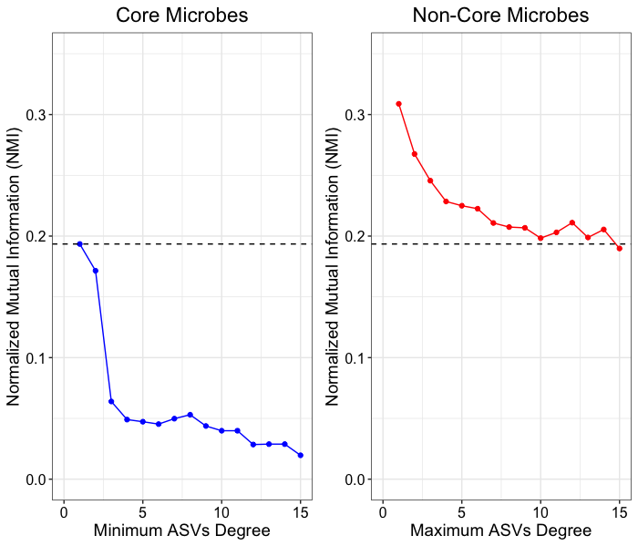
The pattern is driven by rare microbes that clustered in small modules associated to specific land uses

Slide 22
Hypotheses
Random – neutral process
Environmental filtering – attributes of the land uses
Rattus movement – dispersal between grids
Dispersal of microbes – dispersal between hosts and species
Human interference

Slide 23
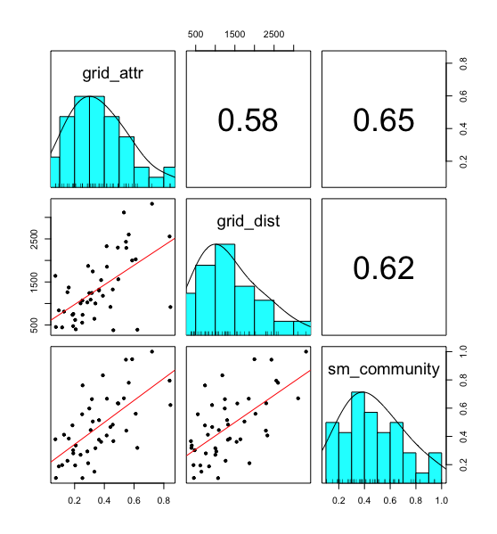
Correlation between variables
Variable Inflated Factor (VIF)
grid_attr grid_dist sm_community
1.753559 1.578721 2.132311

Slide 24
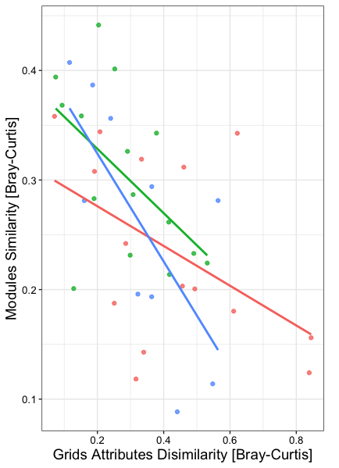
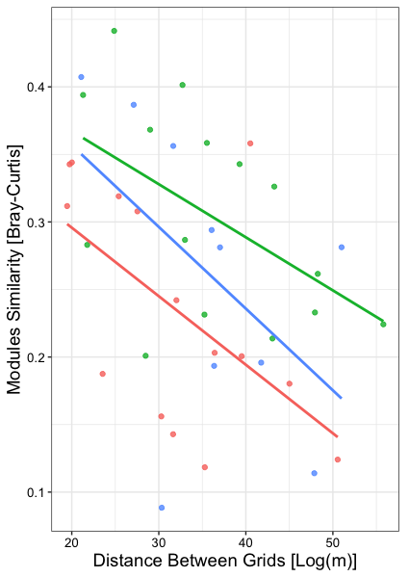
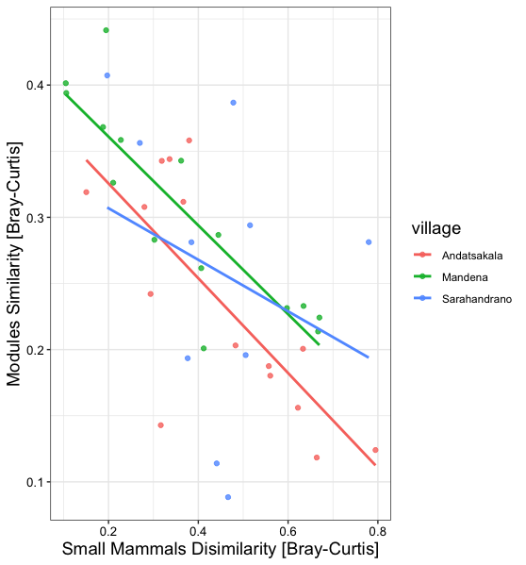
Similarity in modules between grids

Slide 25
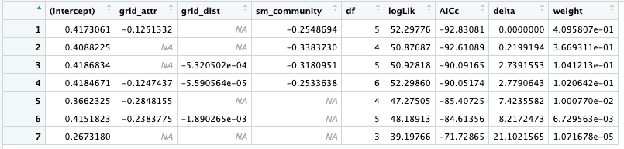
Model selection

Slide 26
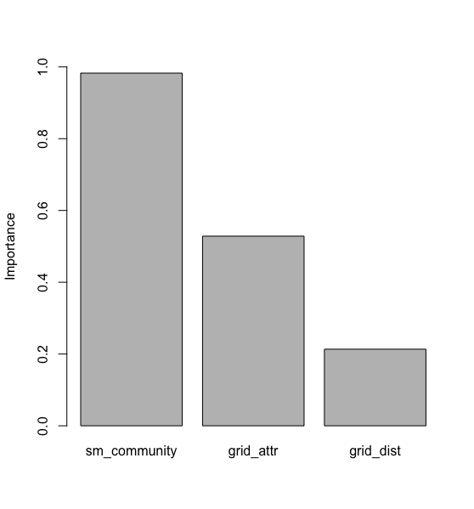
Model selection

Slide 27
Summary
Land use signal in the host-microbe network at the meso-scale
Weak signal of land use in the network structure driven by rare microbes that clustered in small modules associated to specific land uses
Closer grids share more modules
Notes:
We didn’t find land use signal at the node scale but just at the meso-scale.
However, this land use signal is weak, and probably driven by rare microbes that clustered in small modules associated to specific land uses.

Slide 28
Doing next – ML analysis
Can we predict links in a certain land use from other land uses?
Can we better predict for one host species?
What are the most important features?
Notes:
We didn’t find land use signal at the node scale but just at the meso-scale.
However, this land use signal is weak, and probably driven by rare microbes that clustered in small modules associated to specific land uses.

Slide 29
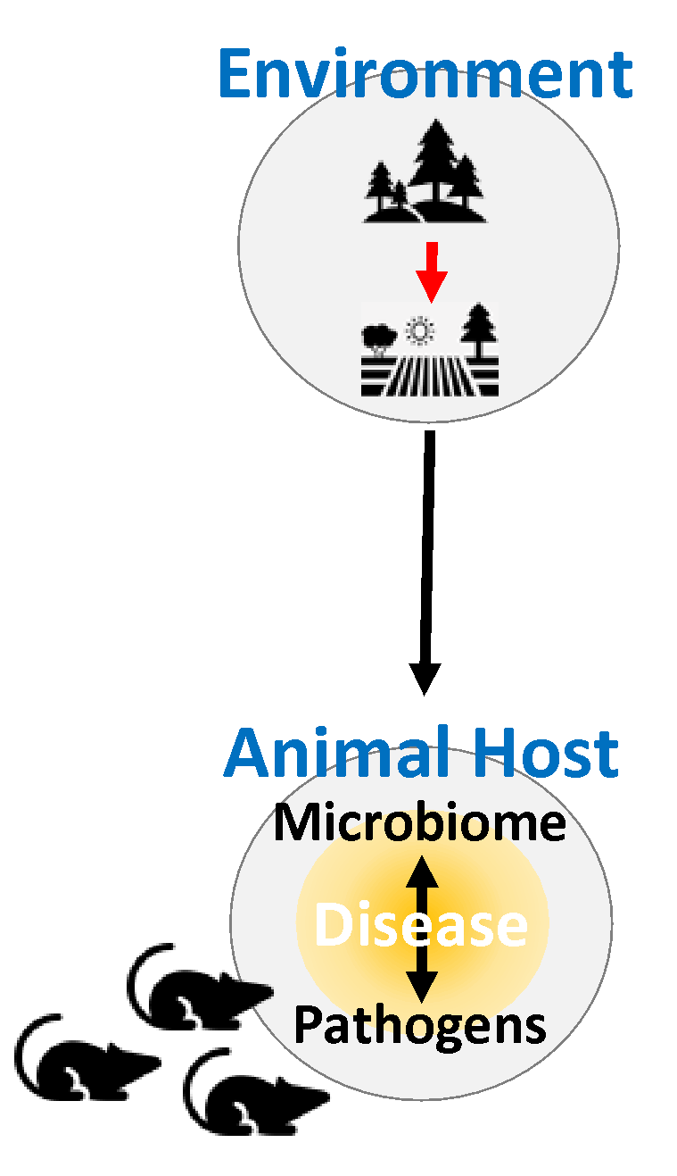
Doing next – adding the pathogens
Host-pathogens and microbiome-pathogens association across land use

Slide 30
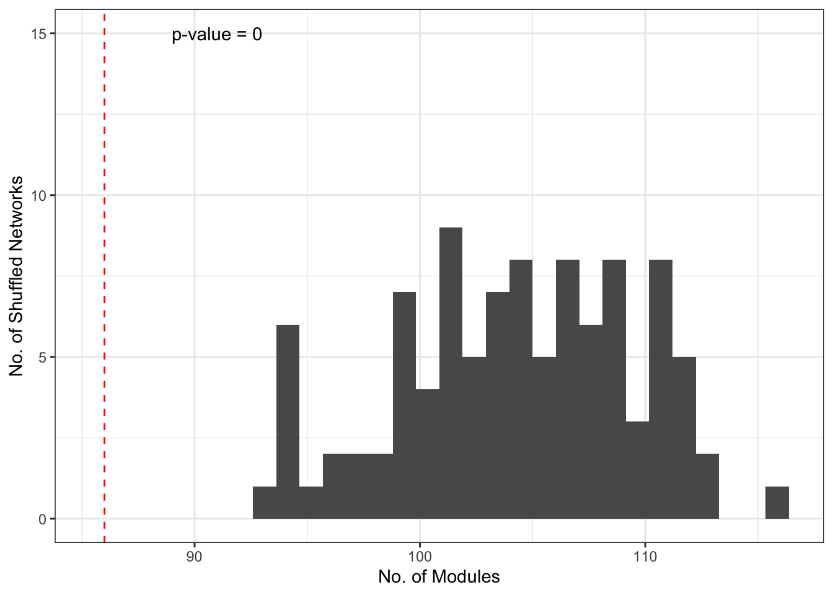
Number of modules

Slide 31
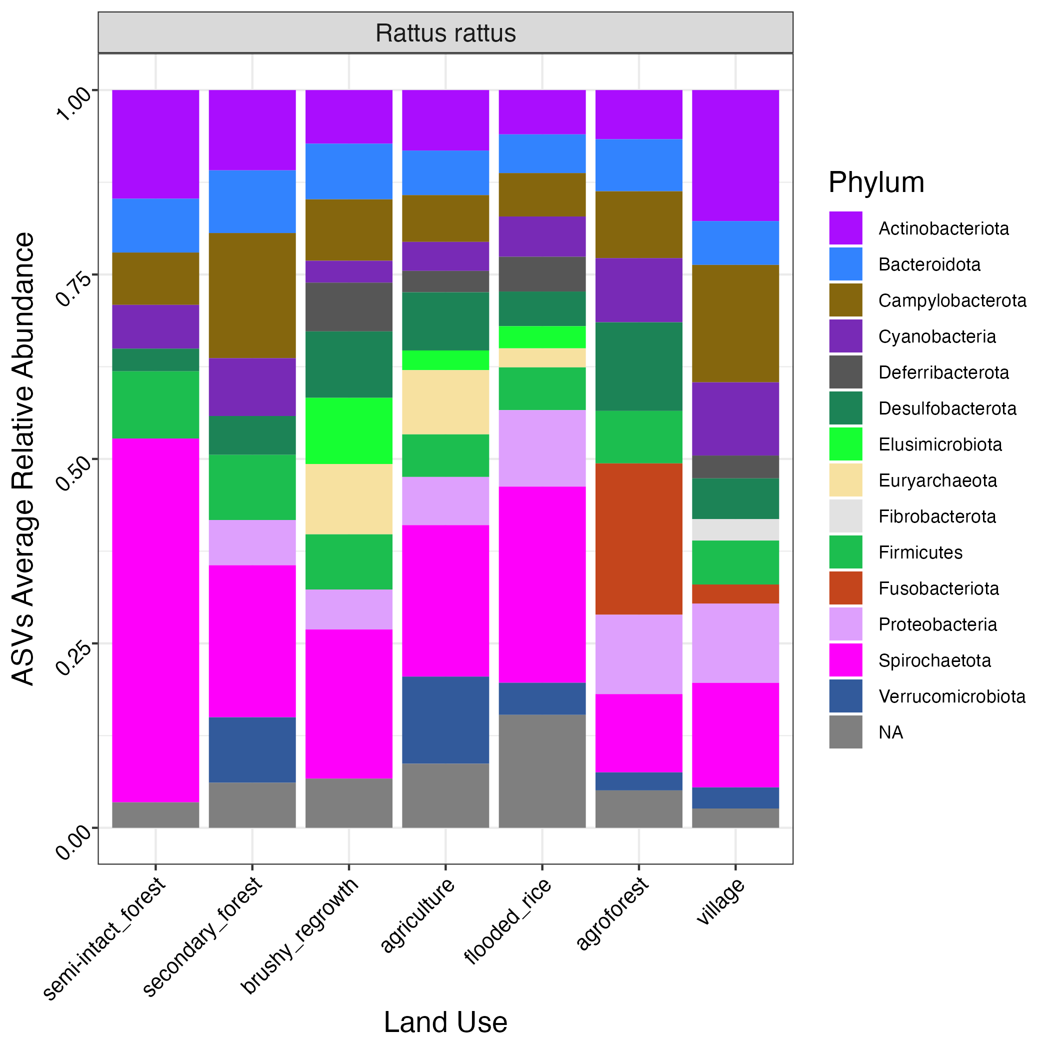
ASVs taxonomy

